Slide 1
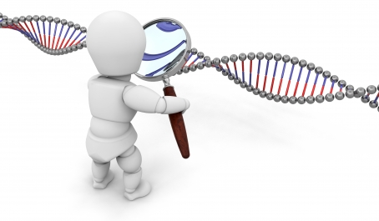
Breast Cancer Subtype Identification Using RNA-Seq Data
Dvir Netanely
Shamir’s Group Meeting
Tel-Aviv University
June 2013

Slide 2

Breast Cancer
A Common disease
  1,300,000 cases, 450,000 deaths each year worldwide
Heterogeneous with respect to
  Molecular alterations
    Many different cellular scenarios can lead to cancer
  Cellular composition
    Tumors are composed of several types of cells
  Clinical outcome
    Outcome prediction is challenging

Slide 3
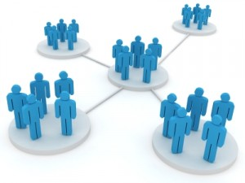
Breast Cancer Clinical Subtypes
Breast cancer tumors are clinically categorized into three basic groups, each with its own therapeutic approach:
  ER+ (Luminal)
  HER2
  Basal-like (Triple-negative)
Classification of breast cancer tumors into distinct subtypes is critical for planning treatment and for developing new therapies.

Slide 4
Project Goals
Improve the classification of cancer samples into therapeutically-relevant utilizing the flood of new high throughput data sources.
Identify biomarkers that are specific to certain subtypes, outcomes.

Slide 5
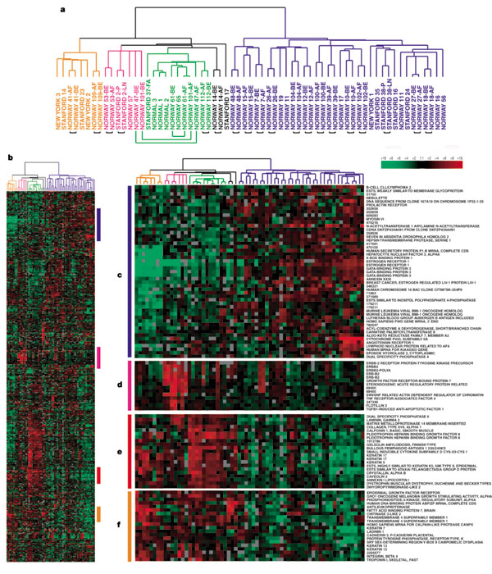
Breast cancer subtype classification based on gene expression
In 2000, Botstein et al. identified 4 classes of breast cancer based on gene expression analysis.
65 samples, 496 genes were used for clustering.
Identified 4 molecular sub-types:
  ER+/luminal-like
  Basal-like
  Her2 (Erb-B2+)
  Normal-like
Molecular portraits of human breast tumours
David Botstein et al., Nature 406, 747-752 (17 August 2000)

Slide 6
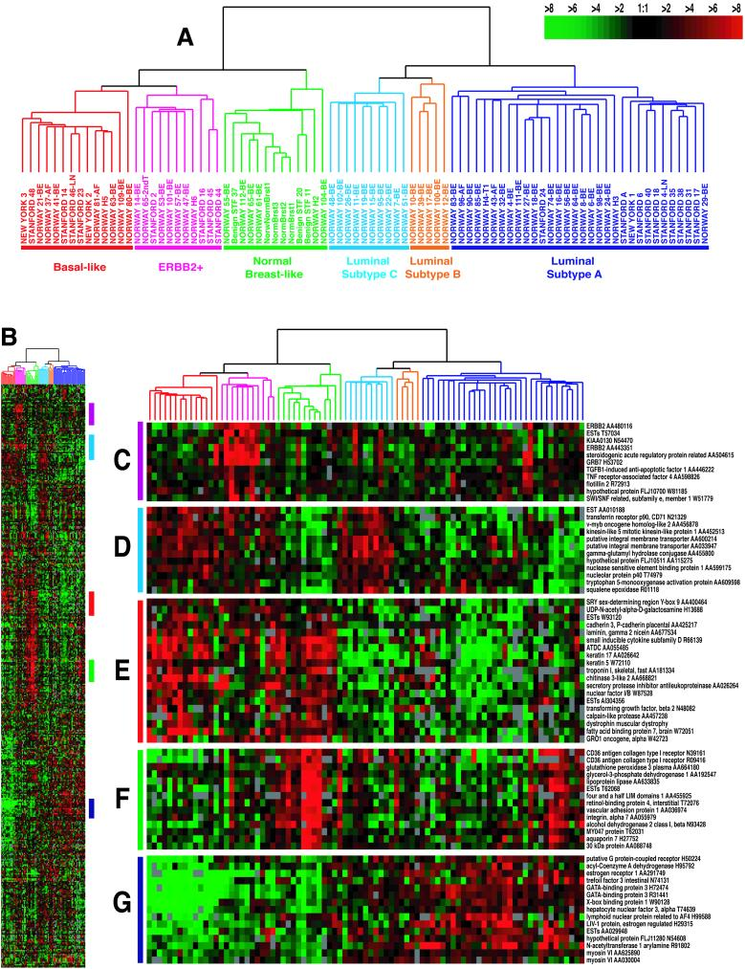
Breast cancer subtype classification based on gene expression
“Gene expression patterns of breast carcinomas distinguish tumor subclasses with clinical implications”, Botstein et al. 2001
85 cDNA microarrays, newer chip, same genes as in the previous study.
Identified five robust sub-types:
  Luminal A
  Luminal B
  HER2-enriched
  Basal-like
  Normal-like
Luminal was divided into two subgroups.
Survival analyses on a subcohort of patients showed significantly different outcomes for the patients belonging to the various groups.

Slide 7
PAM50 Classifier
In 2009, Parker et al. derived a set of 50 genes that robustly classify the five above subtypes of breast cancer.
Analysis based on 189 tumors, 29 normal.
The PAM50 gene set has high agreement in classification with larger “intrinsic” gene sets previously used for subtyping, and is now commonly employed.
Supervised Risk Predictor of Breast Cancer Based on Intrinsic Subtypes, Parker at al. 2009

Slide 8
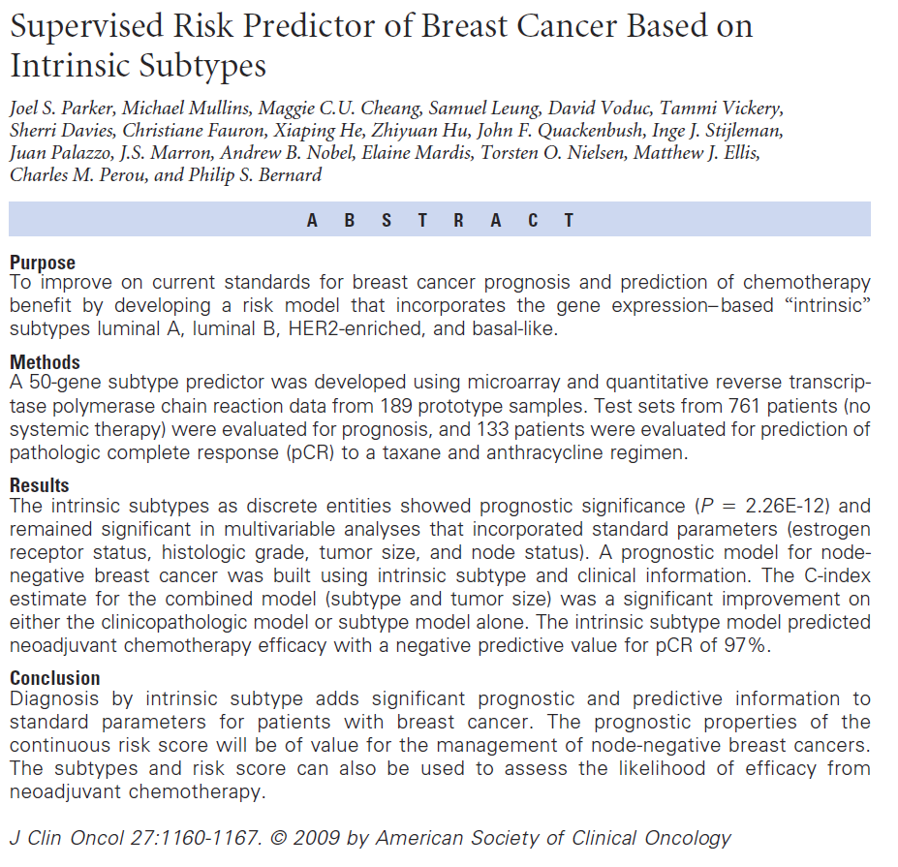
PAM50

Slide 9
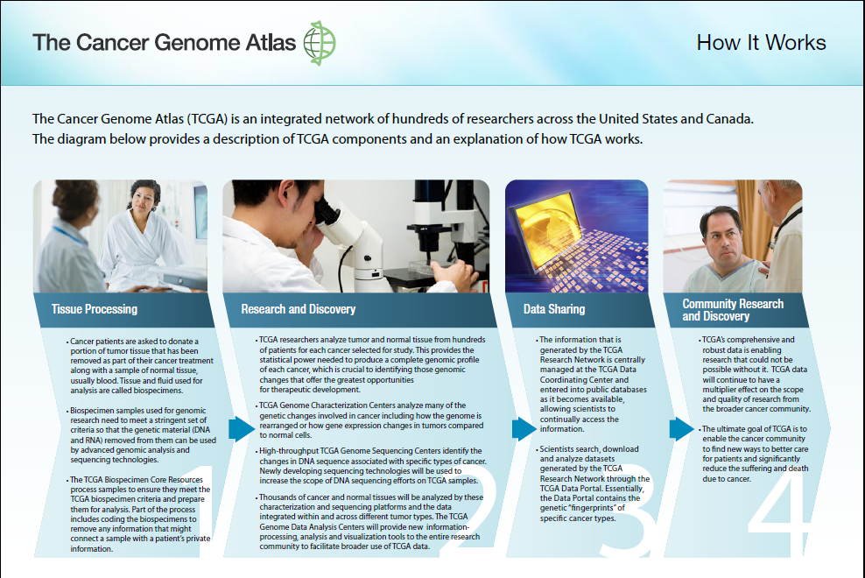

Comprehensive molecular portraits of human breast tumours
The Cancer Genome Atlas Network
Nature Volume: 490, Pages:61–70 October 2012
Identification of Breast Cancer subtypes based on data coming from five different technologies (not including RNA-Seq)

Slide 10
Paper’s Essence
466 Breast cancer samples from 825 patients were clustered based on data coming from 5 different technologies.
Showed correlation between yielded clusters and PAM50 labels.
Additionally performed “consensus clustering” which is a clustering of the clusters produced independently by the various technologies.

Slide 11
Technologies used
mRNA microarrays
  Measures mRNA levels for thousands of genes based on probe hybridization
DNA methylation arrays
  Detects methylation levels
Genomic DNA copy number arrays
  Identifies amplifications and deletions on the DNA level
Exome sequencing
  Identifies genetic variance in the form of somatic mutations within the coding regions of the genome (1% of the genome).
microRNA sequencing
  Measures miRNA levels using deep sequencing
Reverse-phase protein arrays
  Measures protein abundance using antibodies

Slide 12
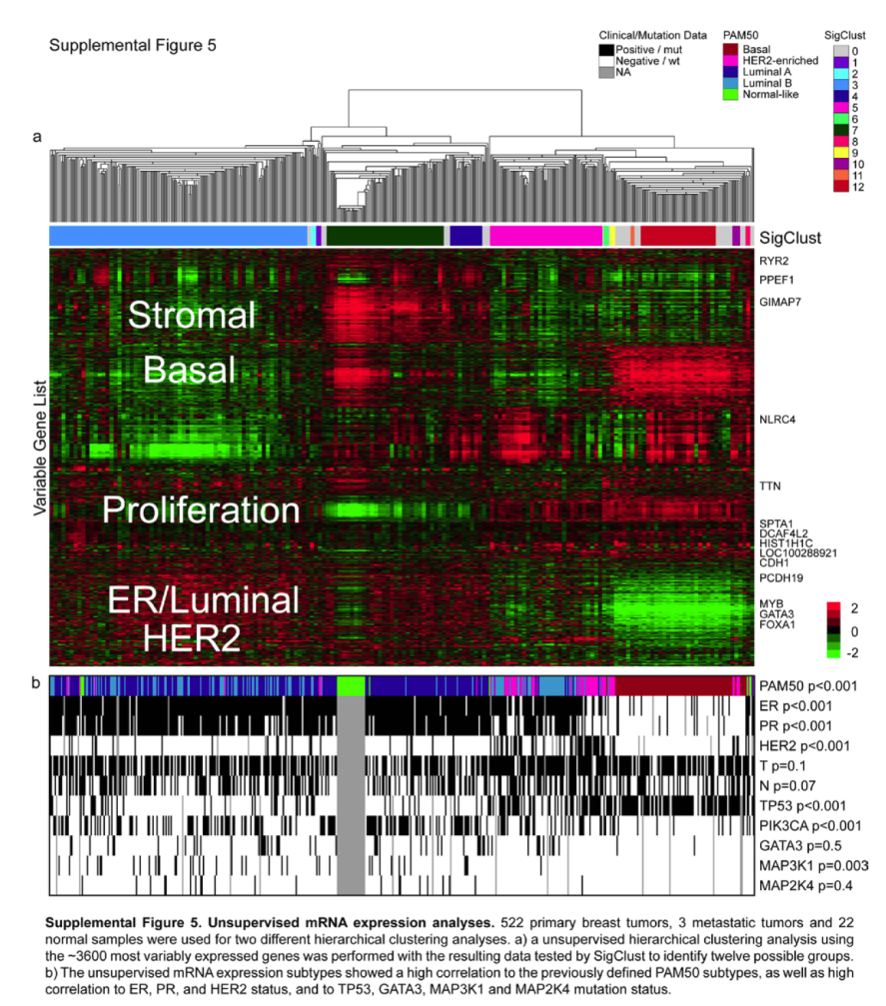
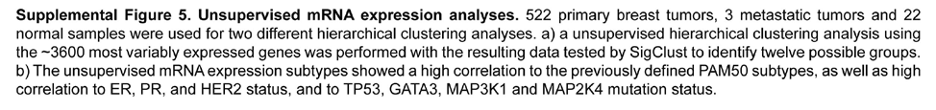
mRNA microarrays analysis
Unsupervised hierarchical clustering analysis of 525 tumours and 22 tumour-adjacent normal tissues using the top 3,662 variably expressed genes.
>High correlation to PAM50 subtypes and to clinical data.

Slide 13


Slide 14
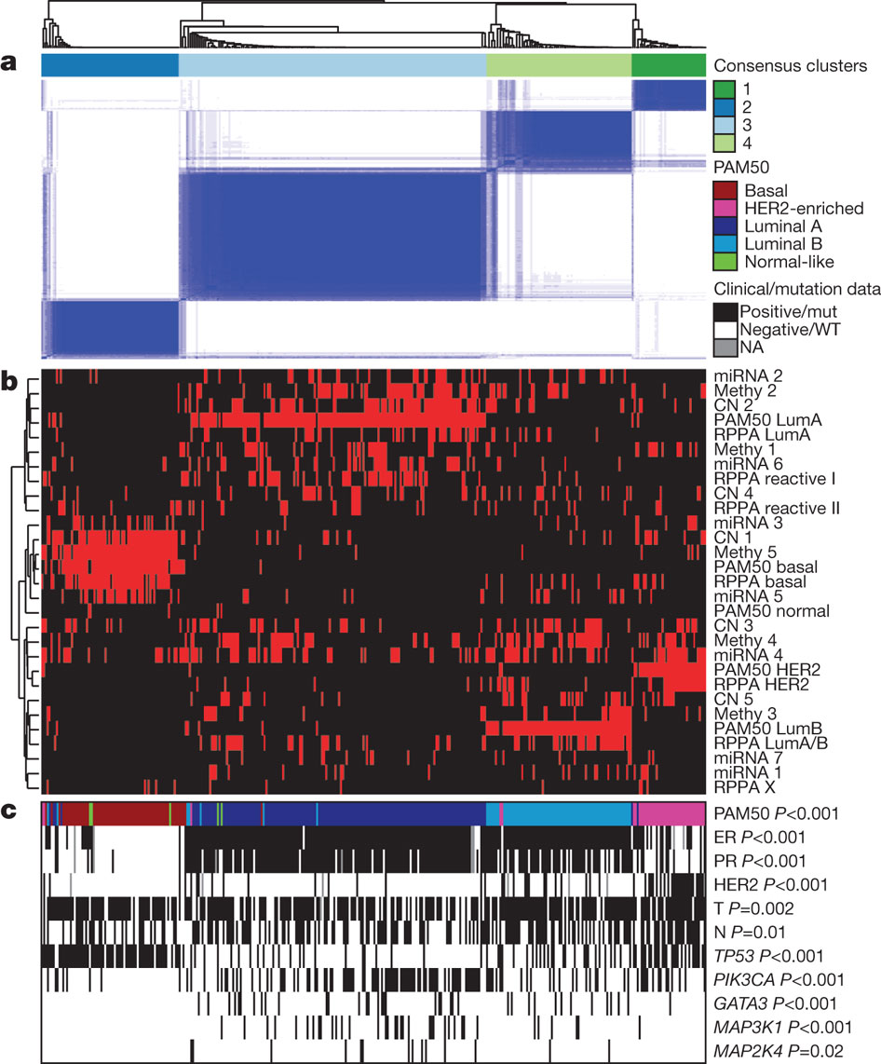
Coordinated analysis of breast cancer subtypes defined from five
different genomic/proteomic platforms.
a, Consensus clustering analysis of the subtypes identifies four major groups (samples, n = 348). The blue and white heat map displays sample consensus.
b, Heat-map display of the subtypes defined independently by miRNAs, DNA methylation, copy number (CN), PAM50 mRNA expression, and RPPA expression. The red bar indicates membership of a cluster type.
c, Associations with molecular and clinical features. P values were calculated using a chi-squared test.
DC Koboldt et al. Nature (2012)

Slide 15
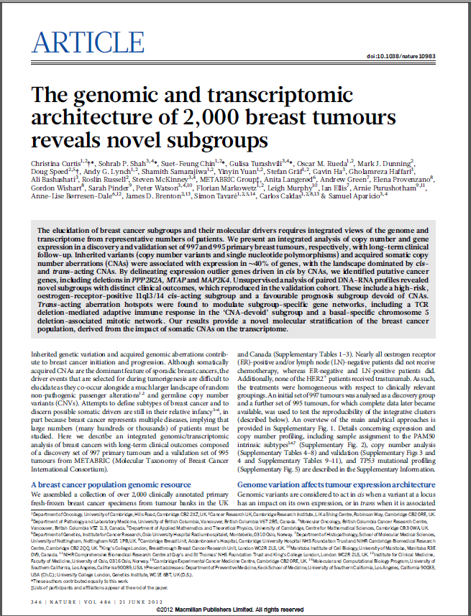
Another paper about detecting BRCA subtypes – 10 subtypes
Detected 10 subtypes with distinct outcomes
Two types of data:
Expression:
  HumanHT-12 v3 Expression BeadChip – Illumina
Copy number:
  Aymetrix SNP 6.0 platform
Using as external labels:
PAM50
GENIUS
    http://genomebiology.com/content/11/2/R18
Integrative clustering using iCluster (2009):
Joint latent variable framework for integrative clustering

Slide 16
RNA-Seq Based Identification of Breast Cancer Subtypes

Slide 17
RNA-Seq
RNA-Seq is a recently developed approach to transcriptome profiling that uses deep-sequencing technologies.
Like microarrays it can provide mRNA abundance quantification and considered to be…
  More precise
  Less noisy
  Higher dynamic range
  Also provides the RNA sequence itself

Slide 18
The TCGA RNA-Seq Breast Cancer Dataset
RNA-Seq data and Clinical data for 956 samples were downloaded from TCGA web site
  107 Normals, 849 Tumors
  20531 genes
  Sample annotations include PAM50 labels.
PAM50 Label Distribution
#Sample | Type
298 | NA
107 | Normal
39 | ?
95 | Basal-Like
56 | Her2
229 | Luminal A
125 | Luminal B
7 | Normal Like

Slide 19
Data Preprocessing
Removed samples for which PAM50 isn’t available
Starting with 20531 genes
Flooring to 4
Log2
Keeping only top 10% variable genes (n=2053)
Standardizing the rows

Slide 20
Let the Clustering begin…
Goal: Partition the samples into groups exhibiting high correlation to PAM50 labels.
Started with Hierarchical clustering.
Difficult to visualize (hundreds of samples)
A measure is needed to determine correlation to PAM50 labels.

Slide 21
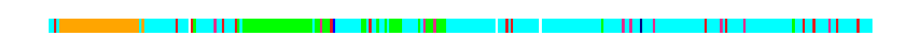
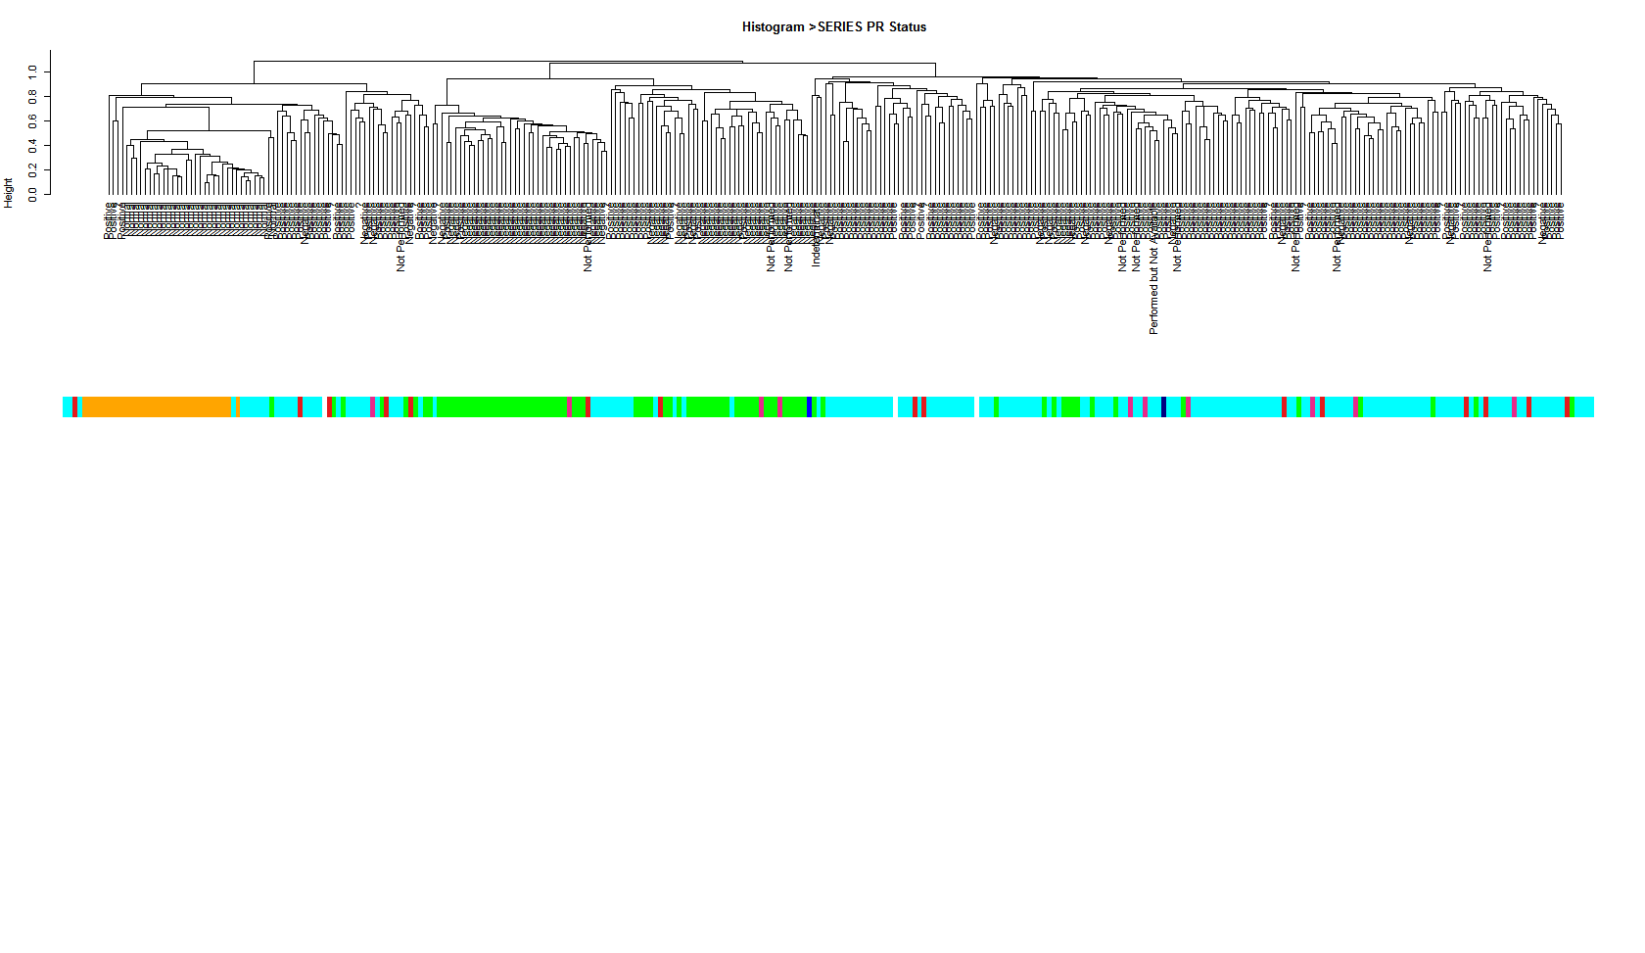
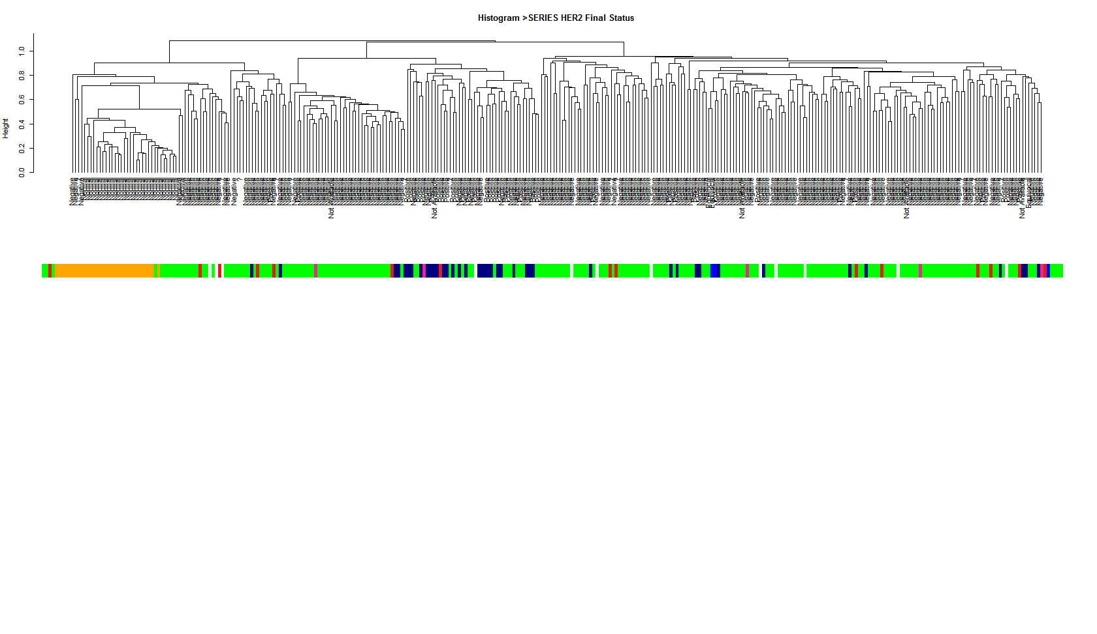
Applying hierarchical clustering on samples 1:3:956
PAM50
Normal
Her2
LuminalA
LuminalB
ER
Negative
Positive
PR
Negative
Positive
HER2
Negative
Positive
Negative
Normal
Tumor

Slide 22
Applying hierarchical clustering on different subsets of samples
(All samples)

Slide 23
Applying hierarchical clustering on different subsets of samples
(Tumors only, without Normals)

Slide 24
Applying hierarchical clustering on different subsets of samples
(Luminal A, Luminal B, normal-like)

Slide 25
Insights
PAM50 subtype detection – some labels are easier to detect than others. From easiest to hardest:
  Normal
  Basal-Like
  Her2
  Luminal B
  Luminal A
Decision Tree approach in place? Multi step algorithm that uses different gene subsets for every step ?
A measure is needed for evaluating clustering solutions and their correspondence to external labels.
Global score or per cluster score ?

Slide 26
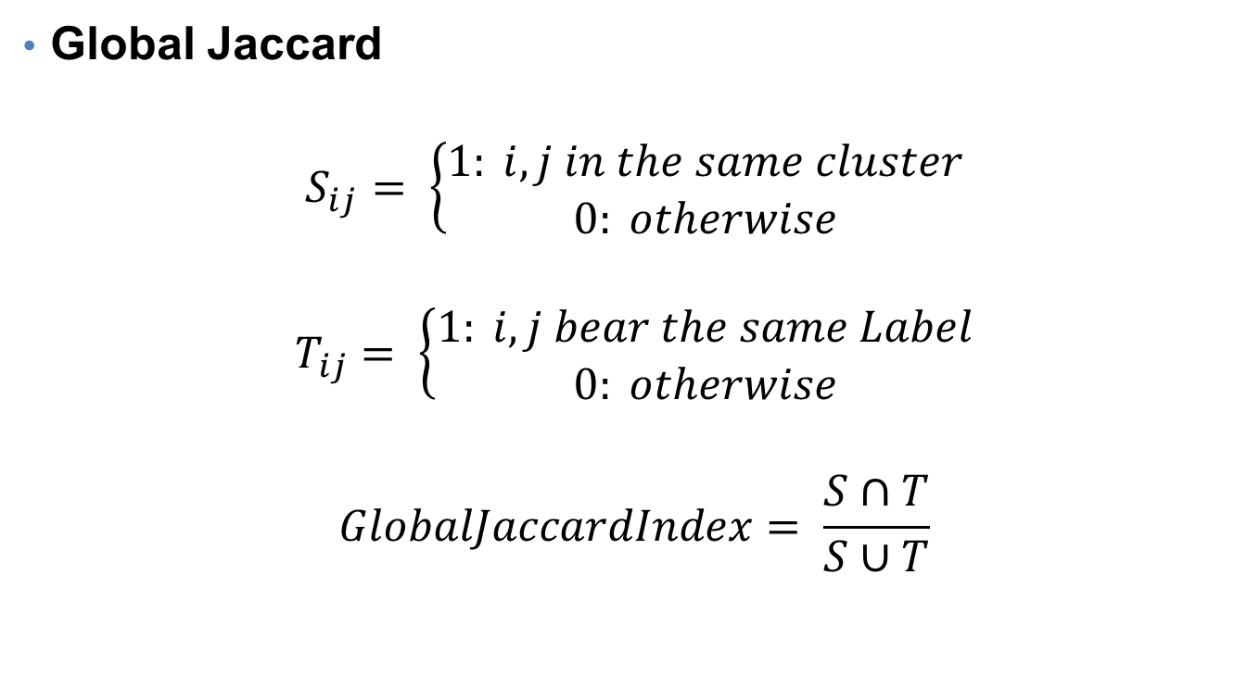
Finding measures for evaluating clustering solutions I
Global Jaccard
$$S_{ij}= \left\{\begin{aligned}1: i,j in the same cluster \\ 0: otherwise\end{aligned}\right.$$
$$T_{ij}= \left\{\begin{aligned}1: i,j bear the same Label \\ 0: otherwise\end{aligned}\right.$$
$$GlobalJaccardIndex= \frac{S∩T}{S∪T}$$

Slide 27
Intersection of Clustering sol. and PAM50 (Samples ordered by PAM50)

Slide 28
Intersection of Clustering sol. and PAM50

Slide 29
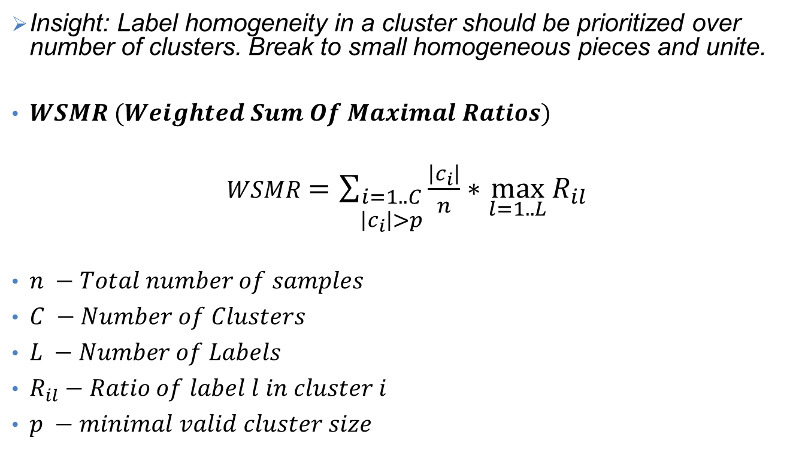
Finding measures for evaluating clustering solutions II
Insight: Label homogeneity in a cluster should be prioritized over number of clusters. Break to small homogeneous pieces and unite.
$WSMR (Weighted Sum Of Maximal Ratios)$
$WSMR$ $=\sum_{\begin{aligned}i=1..C \\ \left|c_{i}\right|>p\end{aligned}}{\frac{\left|c_{i}\right|}{n}∗\max_{l=1..L}{R_{il}}}$
$n −Total number of samples$
$C −Number of Clusters$
$L −Number of Labels$
$R_{il}−Ratio of label l in cluster i$
$p −minimal valid cluster size$

Slide 30
Applying the two measures on various clustering solutions (Hierarchical Clustering, Euclidean distance, Complete linkage)

Slide 31
Intersection block diagram
(Hierarchical Clustering, Euclidean distance, Complete linkage)

Slide 32
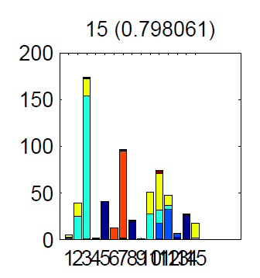
Which parameter set will yield a clustering solution which best corresponds to PAM50 labels ?
[euclidean] [complete] | 15 | 0.798061
[seuclidean] [complete] | 15 | 0.798061
[minkowski] [complete] | 15 | 0.798061
[euclidean] [ward] | 20 | 0.79483
[euclidean] [ward] | 30 | 0.79483
[euclidean] [ward] | 40 | 0.793215
[cosine] [complete] | 30 | 0.789984
[spearman] [complete] | 30 | 0.785137
[euclidean] [ward] | 50 | 0.783522
[spearman] [complete] | 20 | 0.783522
[spearman] [complete] | 40 | 0.783522
[cosine] [complete] | 40 | 0.781906
[correlation] [complete] | 40 | 0.781906
[euclidean] [complete] | 20 | 0.778675
[seuclidean] [complete] | 20 | 0.778675
[cityblock] [complete] | 30 | 0.778675
[minkowski] [complete] | 20 | 0.778675
[cosine] [complete] | 20 | 0.775444
[correlation] [complete] | 30 | 0.775444
[correlation] [complete] | 50 | 0.772213

Slide 33
KMeans - Correlation

Slide 34
KMeans 15 - 0.83

Slide 35
Click – Correlation distance metric

Slide 36
Click – Dot Product distance metric

Slide 37
Insights
Better measurement is out there ? One that will penalize high number of clusters.
Global Jaccard Index prioritizes solutions with the same number of clusters.
KMeans results are random, hard to identify best parameters.

Slide 38
Applying our measures on TCGA’s clusters

Slide 39
Building a clustering based classifier
Find a clustering solution composed of clusters that are highly homogenous with respect to external label.
Assign a single label to each cluster based on calculation of maximal ratio.
Map each new sample to a cluster based on profile correlation.
Assign the new sample with the cluster’s label.

Slide 40
Accuracy distribution over 40 executions
Kmeans 15, correlation- Mean: 0.7512, min:0.669, max:0.830

Slide 41
Kmeans 15, Correlation distance – Example for high score

Slide 44
Accuracy distribution over 40 executions
Kmeans 15, euclidean - Mean: 0.734, min:0.64, max:0.798

Slide 45
Kmeans 15, Euclidiean distance – Example for low score
High WSMR but low accuracy

Slide 49
Summary
Global-Jaccard, WSMR and classifier’s accuracy are all measures indicative of how well our algorithm can cluster the samples into meaningful groups.
Additional measures are needed.
These measures shall be used to fine-tune the clustering algorithm.

Slide 50
Next Steps
Complete development of classifier evaluation measures
Look for better clustering evaluation measure in correlation with classifier accuracy.
Improve classifier by
  Smarter gene selection, better preprocessing
  Identify best clustering algorithm, distance metric, parameters
  Use the two confidence values (R and MaxRatio) to estimate overall prediction confidence
Use different set of genes for each step (Decision tree)
Focus on LuminalA-LuminalB separation
Use additional data sources
Try other classification methods
Look for significant survival differences of patients mapped to different clusters.

